Slide 1







Playing with Tiny bit
Frog beating
Yahboom

Slide 2









Contents
Preparation
Learning goal
Search for blocks
Combine blocks
Experimental phenomena
Yahboom

Slide 3

Preparation
This course is mainly based on the accelerometer that comes with micro:bit.
When we rotate the micro:bit around the x-axis, that is, when rotating on the yoz plane, the degree of the rotation (picth) will be changed.
When we rotate the micro:bit around the y-axis, that is, when rotating on the xoz plane, the degree of the rotation (roll) will be changed.
When we rotate the micro:bit around the z-axis, that is, when rotating on the yoz plane, the degree of the rotation (yaw) will be changed.
In this experiment, we use the rotation angle to judge.
Yahboom

Slide 4
Preparation
Programming method:
Mode 1 online programming: First, we need to connect the micro:bit to the computer by USB cable. The computer will pop up a USB flash drive and click on the URL in the USB flash drive: http://microbit.org/ to enter the programming interface. Add the Yahboom package: https://github.com/YahboomTechnology/Tiny-bitLib to program.
Mode 2 offline programming: We need to open the offline programming software. After the installation is complete, enter the programming interface, click【New Project】, add Yahboom package: https://github.com/YahboomTechnology/Tiny-bitLib, you can program.
Yahboom

Slide 5
Learning goal
1.Learn how to use accelerometer graphically program building blocks
2.The function is realized by programming: when we gently press the tail of the robot car with our hand, the Tiny-bit will make a sound and advance a short distance.
Yahboom

Slide 6

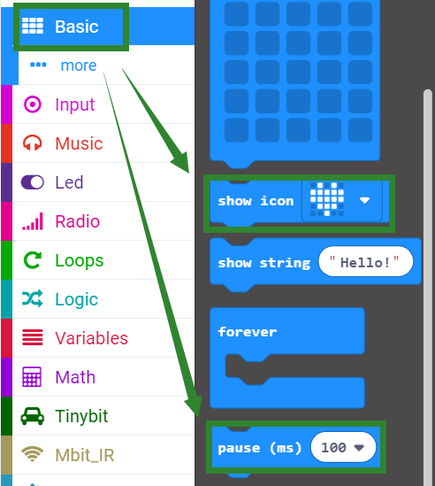
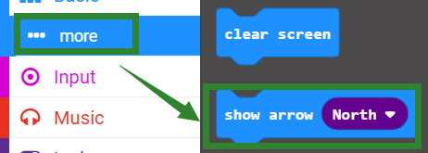
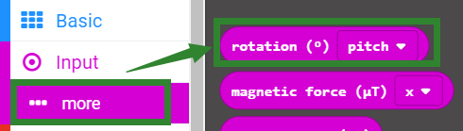
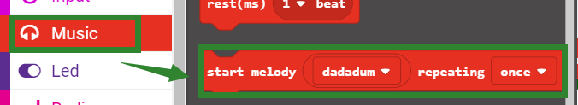
Search for block
The following is the location of the building blocks required for this programming.
Yahboom

Slide 7
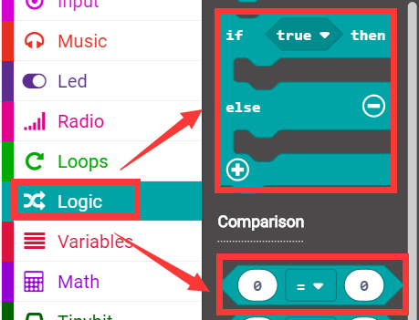
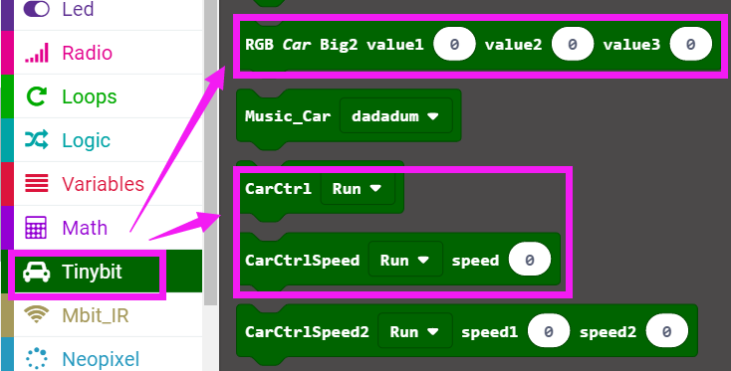
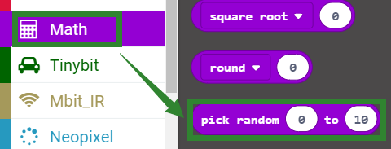
Search for block
Yahboom

Slide 8
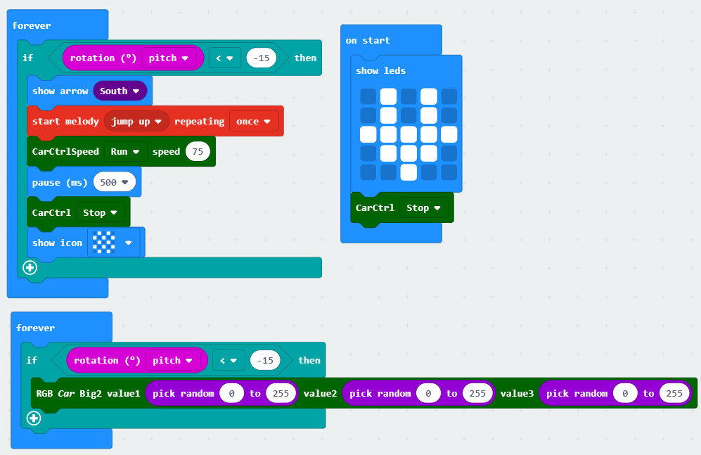
Combine block
The summary program is shown below:
Yahboom

Slide 9
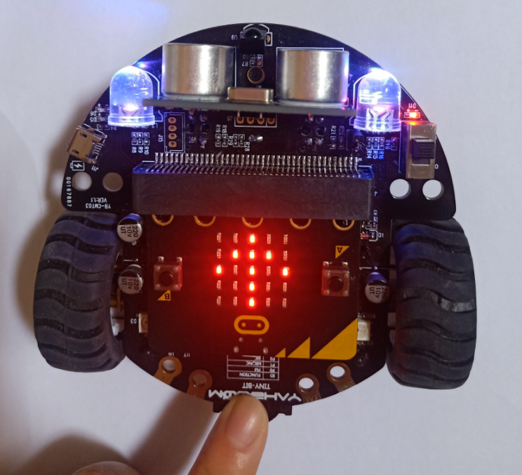
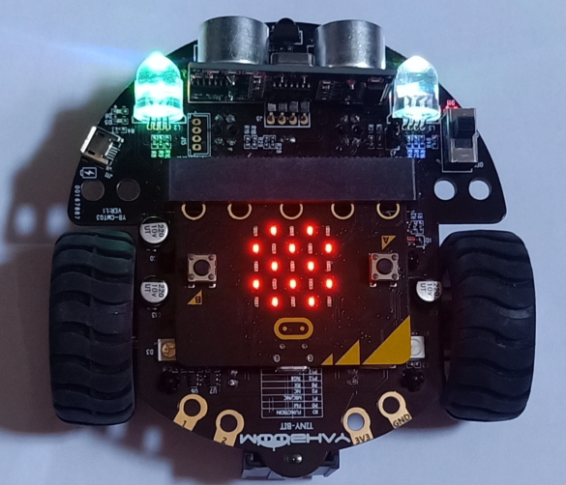
Experimental phenomena
After the program download is complete, open the power of the robot car. When we gently press the tail of the Tiny-bit, the forward arrow will be displayed on the micro:bit dot matrix, and a piece of music will be played, and the lights will be randomly lit at the same time, the car advances for a short time, then stops.
As shown below.
Yahboom

Slide 10
Inspire Creativity Embrace Innovation
Thank you!!!

